Slide 1
FriendZone
Clementine Eckert
William Kummetz
Mario Mendez
Alex Poon
Kevin Welty

Slide 2
FriendZone What we offer
While attending college, it can be difficult to find friends with similar interest. With the busy day-to-day of classes, homework, meetings, and work the FriendZone application can bring people together. FriendZone is a mobile application that will help ASU students find people with similar interests and create friendships through social activities

Slide 3
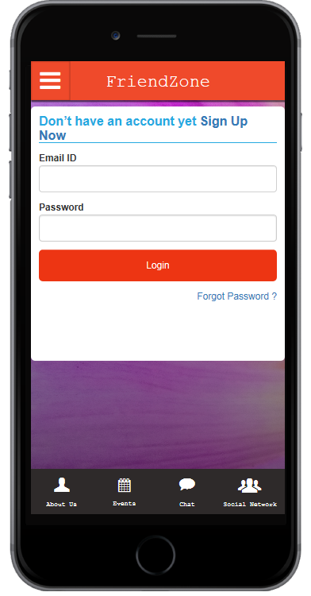
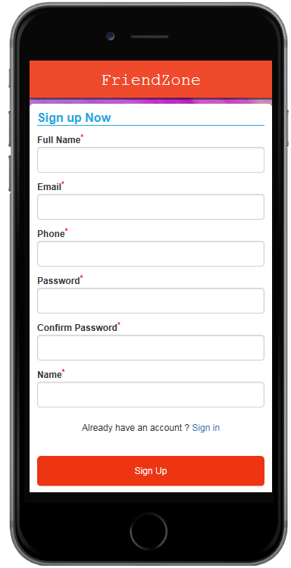
Prototype 1

Slide 4
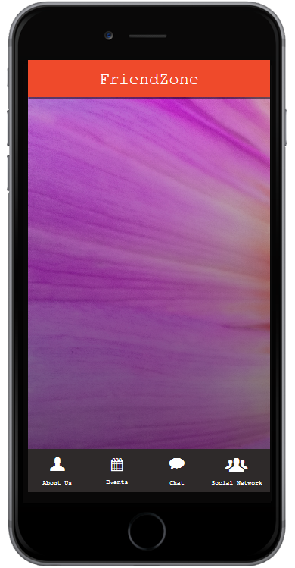

Activities
Bowling
Bowling
Sudoku
Create An Event
Join An Event
Coloring
Whittling

Slide 5

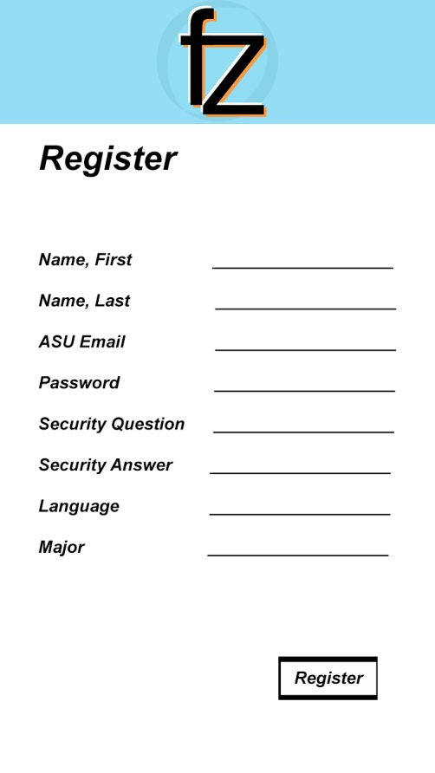
Prototype 2

Slide 6
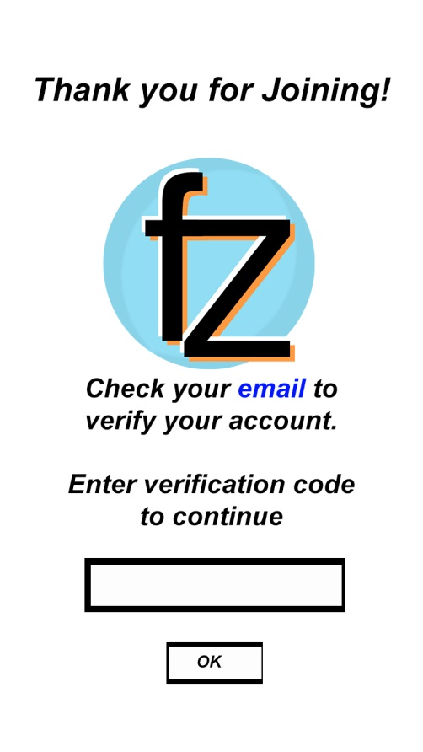
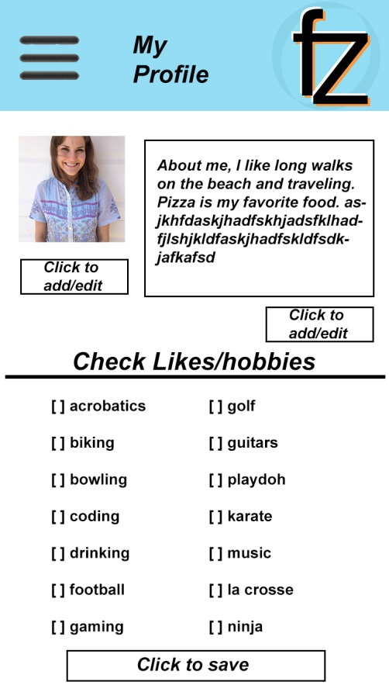

Slide 7
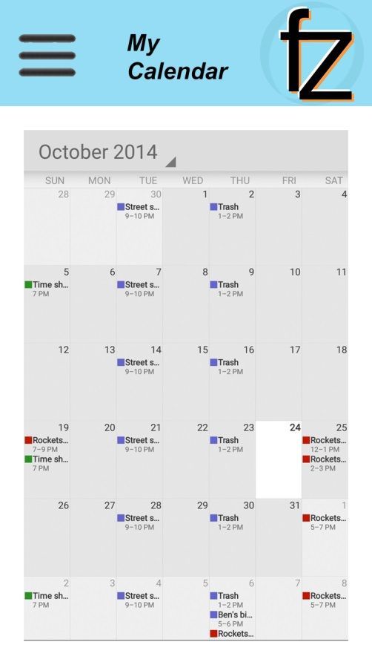
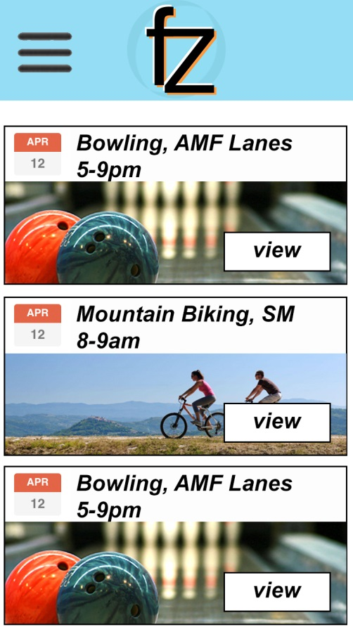

Slide 8
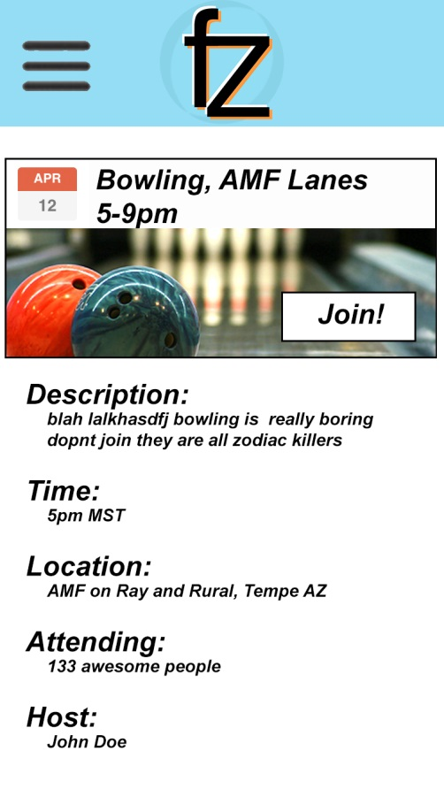
Come join us for a great time at AMF lanes for games of bowling!

Slide 9
Metrics
We will use 2 metrics:
The % of surveyed users who sign up for our service.
The % of people who found an activity in our current list of activities that they would choose to join.
April 14, 2016, Measurement:
The % of survey users who signed up for our service increased by 13% from the previous measurement from 20% to 33%.
The % of people who found an activity increased by 33% from the previous measurement from 0% to 33%.

